Slide 1

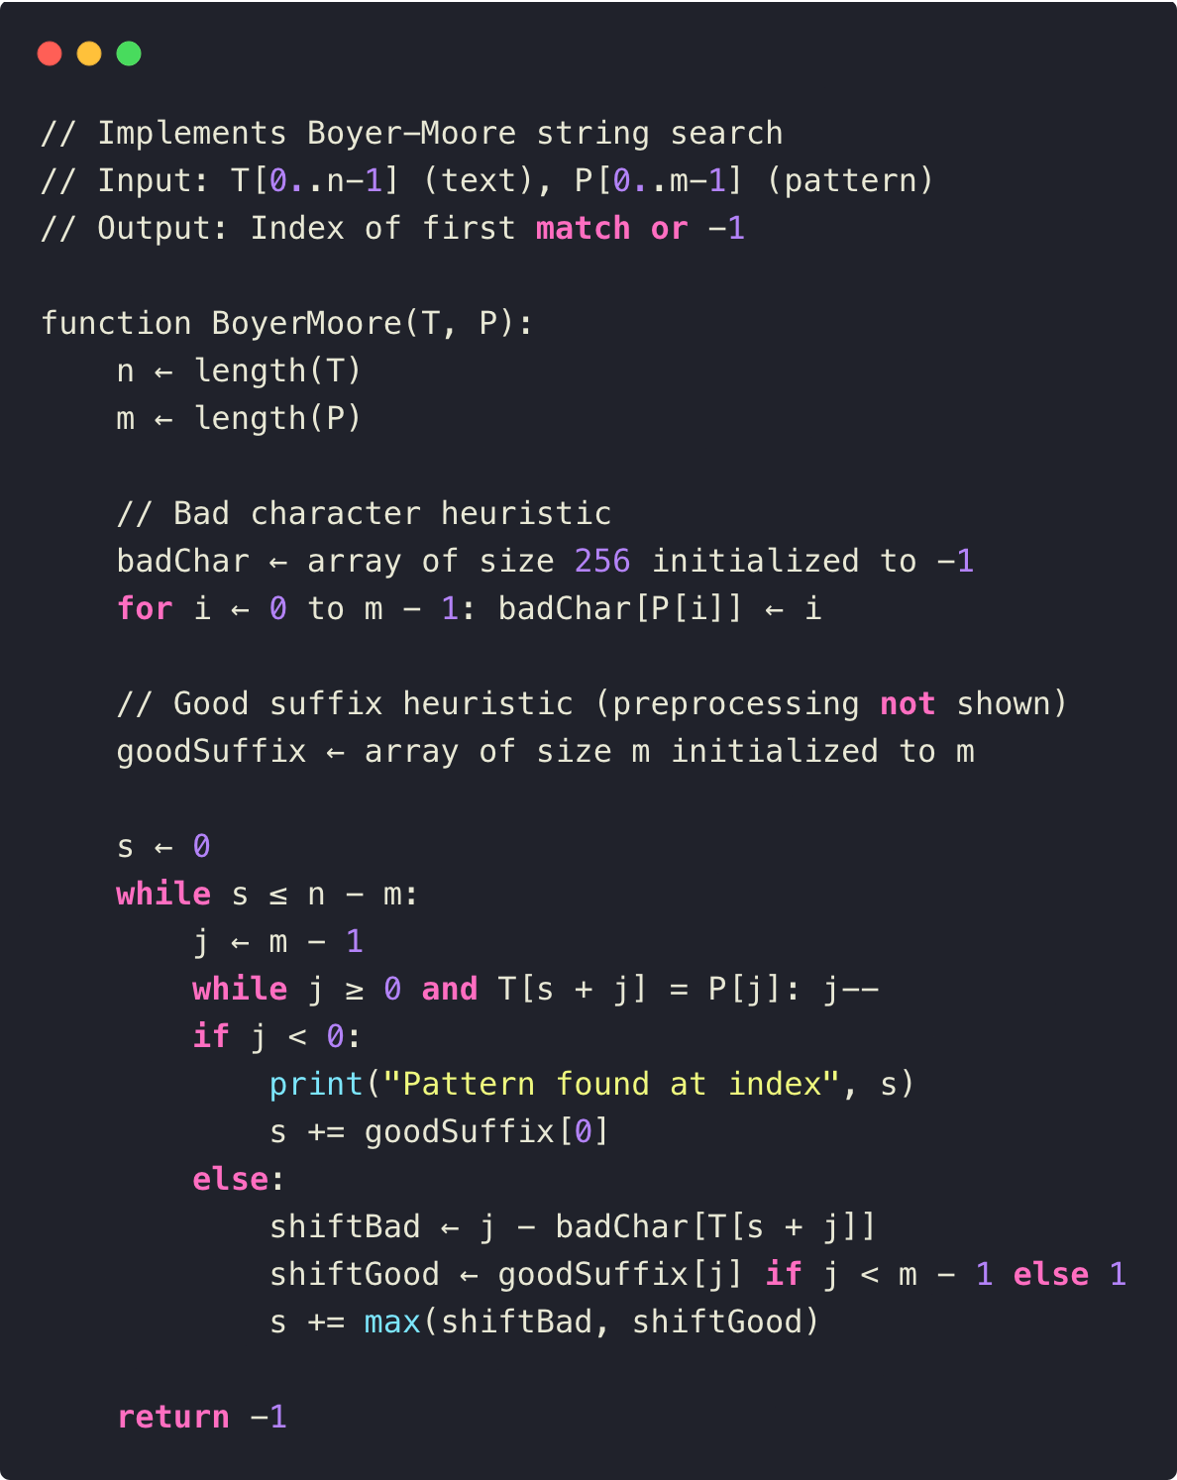
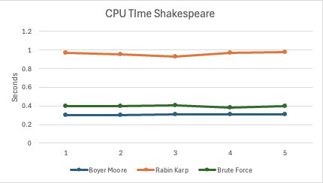
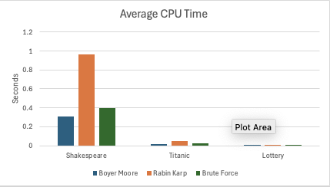
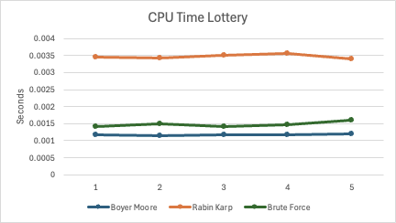
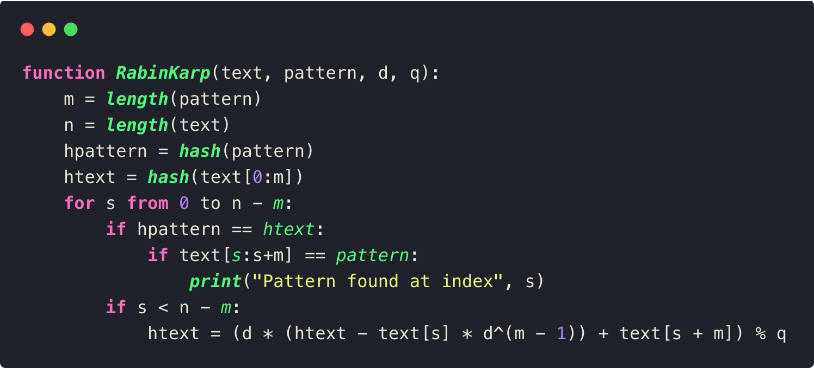
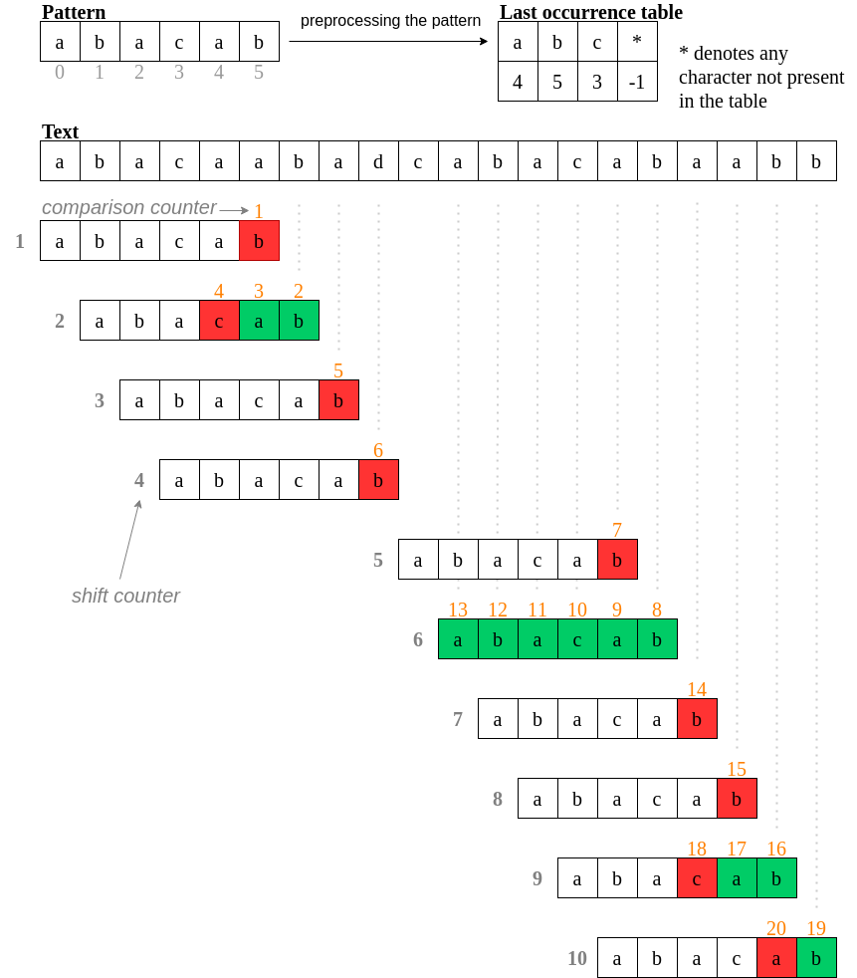
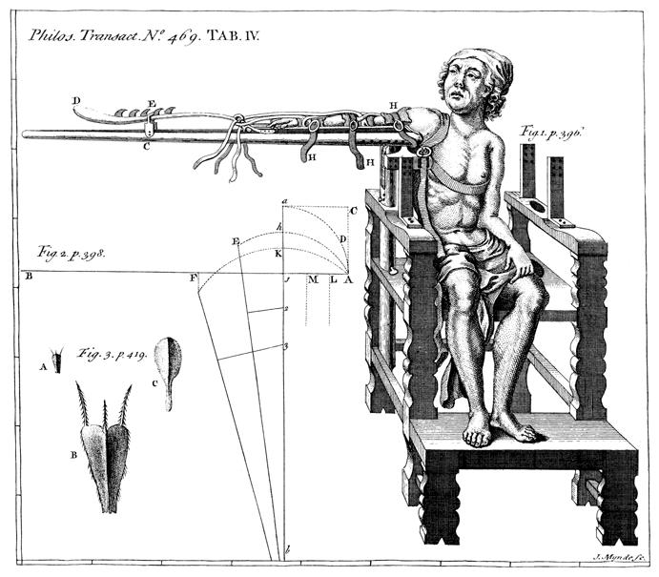
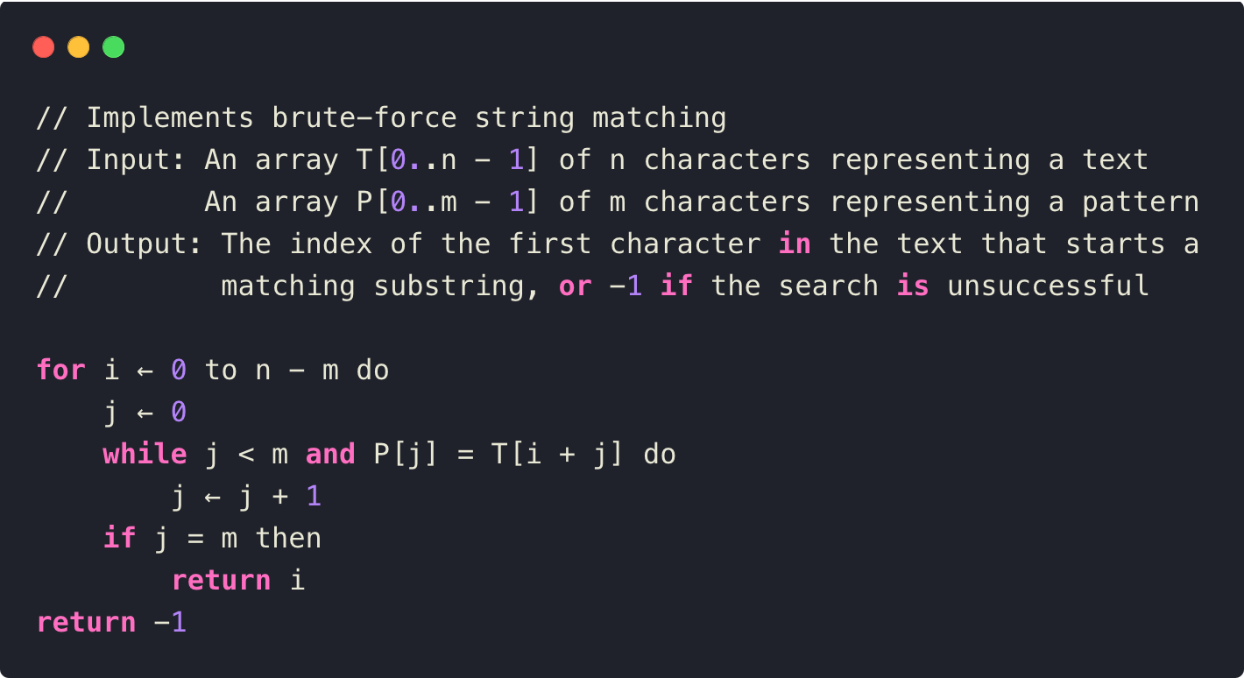
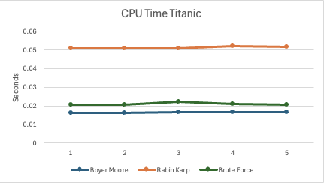
Comparative Analysis of String Searching Algorithms:
Brute Force, Rabin-Karp, and Boyer-Moore
Gavin Miller, John Bacho, Logan Camp Project Mentor: Dr. Christine Cumming Department of Computer Science, Baldwin Wallace University Berea, Ohio 44017
Introduction
String matching is a foundational problem in computer science with applications across areas such as data retrieval, text processing, and computational biology. In the following project, we will compare three well-known string-matching algorithms: Brute Force, Rabin-Karp, and Boyer-Moore. Each of these three algorithms attacks the string searching problem with a different strategy and, therefore, exhibits different performance characteristics concerning computational complexity and efficiency. The Brute Force method, for instance, relies on an exhaustive search approach, while Rabin-Karp incorporates hashing to expedite matching, and Boyer-Moore uses heuristic-based shifts to minimize comparisons. This project investigates the efficiency and trade-offs of each approach under varying conditions, contributing insights that are crucial for selecting optimal algorithms in real-world applications.
The study’s approach involves implementing each algorithm to search for the word "the” - the most common word in the English language - in diverse text datasets, including all of Shakespeare’s Works, the Titanic movie script, and The Lottery (short story). By focusing on this frequently occurring word, the study evaluates the CPU processing time for each algorithm, providing a clear comparison of processing speed and efficiency across different text sizes and structures, which reflects real-world performance in handling common search terms.
Boyer-Moore
The Boyer-Moore algorithm is an efficient string-matching method known for its use of Bad Character and Good Suffix rules, which reduce the number of comparisons needed when searching for a pattern in a dataset. It scans from right to left and can skip portions of the text on mismatches, allowing for large jumps, particularly with unique or repetitive patterns (Figure 1). This results in an average time complexity of O(n/m), where (n) is the text length and (m) is the pattern length (GeeksforGeeks, 2024). While it has a worst-case complexity of O(n*m) for repetitive sequences, its efficiency in practical applications makes it a preferred choice for string matching, especially with large datasets.
Rabin-Karp
The Boyer-Moore algorithm is one of the most efficient string-matching approaches. It’s efficiency derives from its use of *Bad Character* and the *Good Suffix* rules, which decreases the number of comparisons needed to be made in a search for a pattern in a dataset . In the case of Boyer-Moore, it scans from right to left and skipping portions of the text when mismatches occur; this enables it to make large jumps, especially with unique or repetitive patterns (Figure 1). According to GeeksforGeeks (2024) this gives an average time complexity of (O(n/m)), where (n) is the length of the text and (m) is the length of the pattern. Hence, it is faster for typical inputs compared to algorithms such as Brute Force. It has a best-case and average time complexity of O(n/m),
Brute Force
The Boyer-Moore algorithm is one of the most efficient string-matching approaches. It’s efficiency derives from its use of *Bad Character* and the *Good Suffix* rules, which decreases the number of comparisons needed to be made in a search for a pattern in a dataset . In the case of Boyer-Moore, it scans from right to left and skipping portions of the text when mismatches occur; this enables it to make large jumps, especially with unique or repetitive patterns (Figure 1). According to GeeksforGeeks (2024) this gives an average time complexity of (O(n/m)), where (n) is the length of the text and (m) is the length of the pattern. Hence, it is faster for typical inputs compared to algorithms such as Brute Force.
Shakespeare
This dataset, at 5,458,199 characters, contains all the works of William Shakespeare, providing a rich, complex text with varied vocabulary. It's ideal for testing algorithms on large-scale literary data.
Titanic Movie
At 296,482 characters, this modern dialogue-heavy text provides a moderate-sized dataset for testing. The conversational format and repetitive dialogue patterns help evaluate an algorithm’s ability to manage redundancy and handle moderately large text files.
The Lottery
This dataset, with only 20,049 characters, is concise allowing for quick testing of algorithms on smaller inputs. It’s suitable for evaluating an algorithm’s performance on compact datasets and understanding baseline behavior in terms of CPU time.
Conclusions
Looking at our results, we can see how well each algorithms performed with our different texts and finding "the" in our chosen texts.
Looking at our times across all the texts, we see that no matter what scale the dataset is, the Boyer-Moore algorithm consistently runs quicker and finds the string faster than any other of the algorithms.
When we compare the speeds of the other two algorithms, we see that the Rabin-Karp algorithm is the slowest option of the three.
The way that Rabin-Karp works, we have an average and best-case time complexity of O(m + n) where m equals the length of the pattern, which is "the" in our case, and n is the length of the text , but in the worst-case we have a time complexity of O(mn).
The Brute Force algorithm has the same complexity for the worst case, which means that even though they both have similar time complexities, we're getting the worst-case scenario for Rabin-Karp and a better scenario for the Brute Force algorithm.
Materials and Methods
Figure 1. Visualization of the Boyer-Moore algorithm use of pattern shifting for faster string matching
Literature cited
“Boyer Moore Algorithm for Pattern Searching.” GeeksforGeeks, GeeksforGeeks, 11 Mar. 2024, www.geeksforgeeks.org/boyer-moore-algorithm-for-pattern-searching/#.
Levitin, Anany. Introduction to the Design & Analysis of Algorithms. Pearson, 2012.
Figure 2. Illustration of important piece of equipment, or perhaps a flow chart summarizing experimental design. Scanned, hand-drawn illustrations are usually preferable to computer-generated ones.
For further information
Please contact jbacho22@bw.edu, gmiller22@bw.edu, lcamp22@bw.edu. More information on this project can be obtained at https://github.com/JohnBacho/CSC430

